Slide 1





Project: Home Irrigation Control System (HICS) Team: SmartGrass
CSE Senior Design I Detailed Design Specification
January 28th , 2015
Belachew
Haile-Mariam
Gautam
Adhikari
Jeremiah
O’Connor
Tung
Vo
Notes:
This presentation demonstrates the new capabilities of PowerPoint and it is best viewed in Slide Show. These slides are designed to give you great ideas for the presentations you’ll create in PowerPoint 2010!
For more sample templates, click the File tab, and then on the New tab, click Sample Templates.

Slide 2
Architecture Overview
1
Gautam

Slide 3
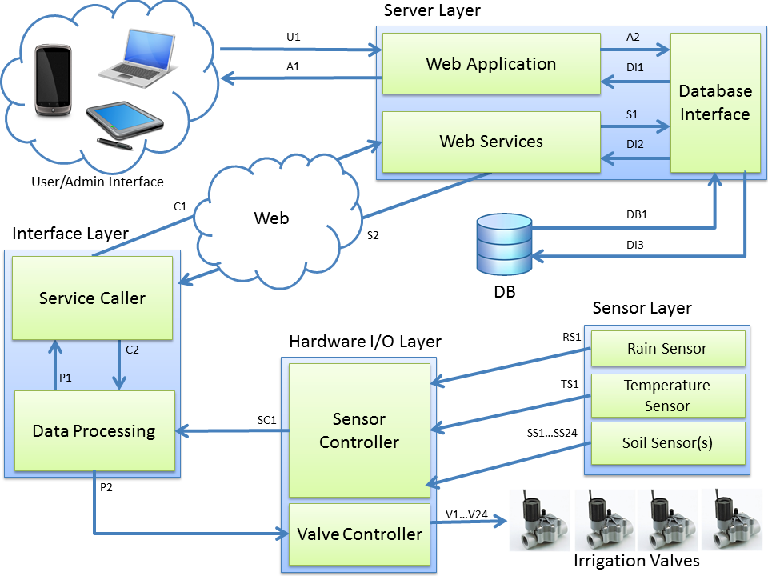
Architecture Overview

Slide 4
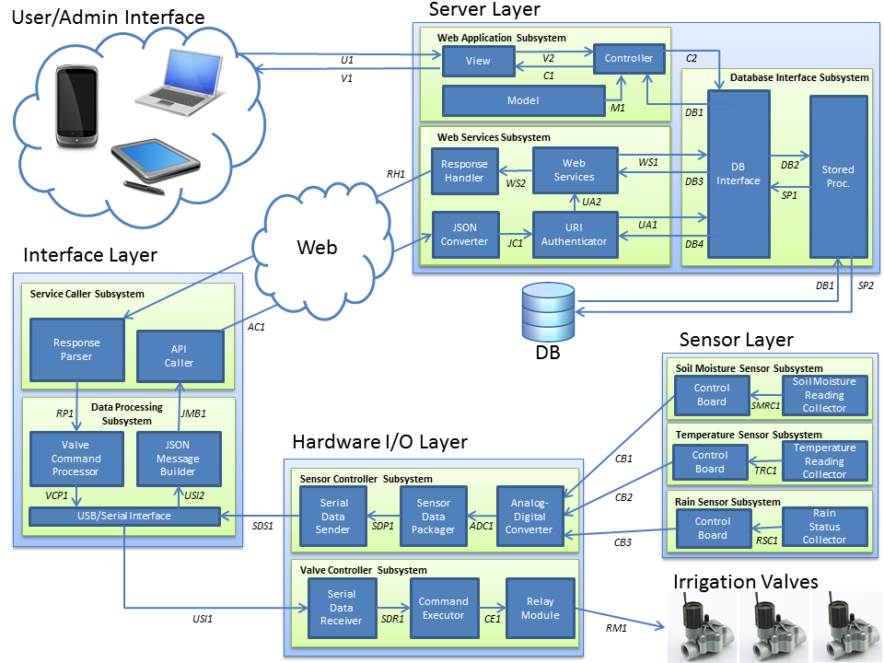
Module Decomposition

Slide 5
Producer-Consumer Matrix
 | Consumer | Soil Moisture Reading Collector | Soil Moisture Sensor Control Board | Temperature Reading Collector | Temperature Sensor Control Board | Rain Status Collector | Rain Sensor Control Board | Analog-Digital Converter | Sensor Data Packager | Serial Data Sender | Relay Module | Irrigation Valve(s) | Command Executor | Serial Data Receiver | USB/Serial Interface | JSON Message Builder | Valve Command Processor | API Caller | Response Parser | JSON Converter | URI Authenticator | Web Services | Response Handler | DB Interface | Stored Procedures | Database | Controller | Model | View | User/Admin
Producer
Soil Moisture Reading Collector |  |  | CMRC1
Soil Moisture Sensor Control Board |  |  |  |  |  |  |  | CB1
Temperature Reading Collector |  |  |  |  | TRC1
Temperature Sensor Control Board |  |  |  |  |  |  |  | CB2
Rain Status Collector |  |  |  |  |  |  | RSC1
Rain Sensor Control Board |  |  |  |  |  |  |  | CB3
Analog-Digital Converter |  |  |  |  |  |  |  |  | ADC1
Sensor Data Packager |  |  |  |  |  |  |  |  |  | SDP1
Serial Data Sender |  |  |  |  |  |  |  |  |  |  |  |  |  |  | RDS1
Relay Module |  |  |  |  |  |  |  |  |  |  |  | RM1
Irrigation Valve(s)
Command Executor |  |  |  |  |  |  |  |  |  |  | CE1
Serial Data Receiver |  |  |  |  |  |  |  |  |  |  |  |  | SDR1
USB/Serial Interface |  |  |  |  |  |  |  |  |  | USI1 |  |  |  |  |  | USI2
JSON Message Builder |  |  |  |  |  |  |  |  |  |  |  |  |  |  |  |  |  | JMB1
Valve Command Processor |  |  |  |  |  |  |  |  |  |  |  |  |  |  | VCP1
API Caller |  |  |  |  |  |  |  |  |  |  |  |  |  |  |  |  |  |  |  | AC1
Response Parser |  |  |  |  |  |  |  |  |  |  |  |  |  |  |  |  | RP1
JSON Converter |  |  |  |  |  |  |  |  |  |  |  |  |  |  |  |  |  |  |  |  | JC1
URI Authenticator |  |  |  |  |  |  |  |  |  |  |  |  |  |  |  |  |  |  |  |  |  | UA2 |  | UA1
Web Services |  |  |  |  |  |  |  |  |  |  |  |  |  |  |  |  |  |  |  |  |  |  | WS2 | WS1
Response Handler |  |  |  |  |  |  |  |  |  |  |  |  |  |  |  |  |  |  | RH1
DB Interface |  |  |  |  |  |  |  |  |  |  |  |  |  |  |  |  |  |  |  |  | DB4 | DB3 |  |  | DB2 |  | DB1
Stored Procedures |  |  |  |  |  |  |  |  |  |  |  |  |  |  |  |  |  |  |  |  |  |  |  | SP1 |  | SP2
Database |  |  |  |  |  |  |  |  |  |  |  |  |  |  |  |  |  |  |  |  |  |  |  |  | D1
Controller |  |  |  |  |  |  |  |  |  |  |  |  |  |  |  |  |  |  |  |  |  |  |  | C2 |  |  |  |  | C1
Model |  |  |  |  |  |  |  |  |  |  |  |  |  |  |  |  |  |  |  |  |  |  |  |  |  |  | M1
View |  |  |  |  |  |  |  |  |  |  |  |  |  |  |  |  |  |  |  |  |  |  |  |  |  |  | V2 |  |  | V1
User/Admin |  |  |  |  |  |  |  |  |  |  |  |  |  |  |  |  |  |  |  |  |  |  |  |  |  |  |  |  | U1

Slide 6
SYSTEM HARDWARE DESCRIPTION
2
Tung

Slide 7
System Hardware Description
Raspberry Pi
Model | Raspberry Pi B+
SoC | Broadcom BCM2835
CPU | 700 MHz ARM1176JZF -S core
GPU | 250 MHz Broadcom IV
RAM | 512
USB | 4x 2.0 Onboard USB ports
Video Out | HDMI up to 1920x1200 resolution, PAL, NTSC
Audio Out | 3.5mm Jack, HDMI
Storage | Onboard SD/MM/SDIO card slot
Networking | 10/100mbps Ethernet, RJ-45
Peripherals | GPIO, UART, SPI, IIC +3.3V, +5.0V
Power | 700 mA, 5V via MicroUSB or GPIO header
OS | Raspbian

Slide 8
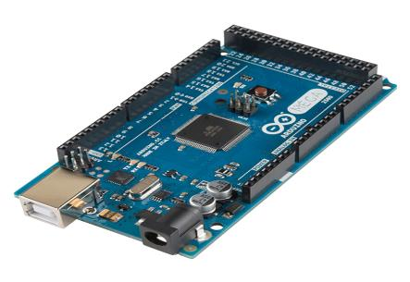
System Hardware Description
Adruino Mega
Model | Arduino Mega ATmega1289
Analog Input Pin | 16
Digital I/O Pins | 54 (of which 14 provide PWM output)
SRAM | 8K
EEPROM | 4KB
Clock Speed | 16MHz
UART Port | 3
I2C | Port
USB port | 1
Operating Voltage | 5V

Slide 9
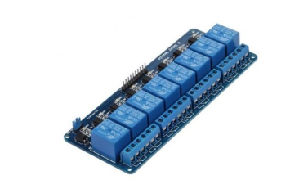
System Hardware Description
Relay Module
Model | SaintSmart 8-Channel Relay
Operating Voltage | 5V
Operating Current | 20mA
Relay Current/Voltage | AC250V 10A, DC 30V 10A
Interface | Arduino Raspberry Pi, ARM, PIC, DSP

Slide 10
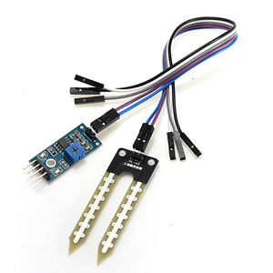
System Hardware Description
Soil Moisture Sensor
Model | TOOGOO Soil Moisture Sensor
Operating Voltage | 3.3V-5V
Digital Output | Yes
Analog Output | Yes
Adjustable Sensitivity | Yes

Slide 11
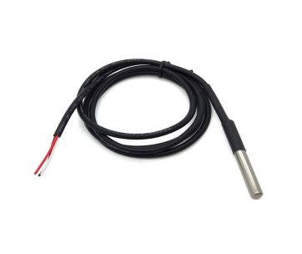
System Hardware Description
Temperature Sensor
Model | DS18B20 Temperature Sensor
Operating Voltage | 3.3V-5V
Analog Output | Yes
Adjustable Resolution | Yes

Slide 12
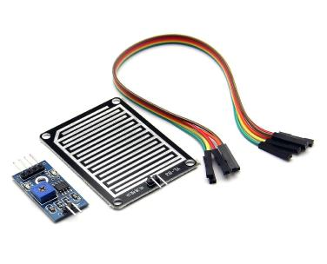
System Hardware Description
Rain Sensor
Model | DS18B20 Temperature Sensor
Operating Voltage | 3.3V-5V
Digital Output | Yes
Adjustable Resolution | Yes

Slide 13
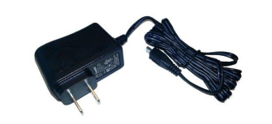
System Hardware Description
AC Power Module
Model | CanaKit 2.5A Micro USB Power Supply
Voltage | 5V
Current | 2.5A

Slide 14
System Software Description
3
Jeremiah

Slide 15
System Software Description
HICS Web Application
ASP.NET MVC 5
.NET Framework 4.5
Razor View Engine 3.0
Entity Framework 6

Slide 16
System Software Description
HICS Hardware Software
Raspberry Pi
Rasbian OS
Processing 2.2.1
Arduino Mega
Arduino Programming Language
APL standard libraries

Slide 17
SENSOR LAYER
4
Billy

Slide 18
Rain Sensor Subsystem
Rain Status Collector
Rain Sensor Subsystem
(Analog-Digital Converter)
CB3
Control Board
Rain
Status Collector
RSC1
Interfaces
Source | Sink | Input to Sink | Return from Sink
Rain Status Collector | Control Board | Analog voltage | None

Slide 19
Rain Sensor Subsystem
Control Board
Rain Sensor Subsystem
Control Board
Rain
Status Collector
(Analog-Digital Converter)
CB3
Control Board
Rain
Status Collector
RSC1
Interfaces
Source | Sink | Input to Sink | Return from Sink
Rain Status Collector | Control Board | Analog voltage | None
Source | Sink | Input to Sink | Return from Sink
Rain Status Collector | Control Board | Analog voltage | None
Control Board | Analog-Digital Converter | Analog voltage | None

Slide 20
Temperature Sensor Subsystem
Temperature Reading Collector
Temperature Sensor Subsystem
(Analog-Digital Converter)
CB2
Control Board
Temperature Reading Collector
TRC1
Interfaces
Source | Sink | Input to Sink | Return from Sink
Temperature Reading Collector | Control Board | Analog voltage | None

Slide 21
Temperature Sensor Subsystem
Control Board
Temperature Sensor Subsystem
Control Board
Temperature Reading Collector
(Analog-Digital Converter)
CB2
Control Board
Temperature
Reading Collector
TRC1
Interfaces
Source | Sink | Input to Sink | Return from Sink
Rain Status Collector | Control Board | Analog voltage | None
Source | Sink | Input to Sink | Return from Sink
Temperature Reading Collector | Control Board | Analog voltage | None
Control Board | Analog-Digital Converter | Analog voltage | None

Slide 22
Soil Moisture Sensor Subsystem
Soil Moisture Reading Collector
Soil Moisture Sensor Subsystem
(Analog-Digital Converter)
CB1
Control Board
Soil Moisture Reading Collector
SMRC1
Interfaces
Source | Sink | Input to Sink | Return from Sink
Soil Moisture Reading Collector | Control Board | Analog voltage | None

Slide 23
Soil Moisture Sensor Subsystem
Control Board
Soil Moisture Sensor Subsystem
Control Board
Soil Moisture Reading Collector
(Analog-Digital Converter)
CB1
Control Board
Soil Moisture Reading Collector
SMRC1
Interfaces
Source | Sink | Input to Sink | Return from Sink
Soil Moisture Reading Collector | Control Board | Analog voltage | None

Slide 24
Hardware I/o Layer
5
Billy

Slide 25
Sensor Controller Subsystem
Analog-Digital Converter
Sensor Controller Subsystem
(Control Board)
Serial Data Sender
Sensor Data Packager
Analog-Digital Converter
CB1
(Control Board)
(USB/Serial Interface)
CB2
SDS1
SDP1
ADC1
(Control Board)
CB3
Interfaces
Source | Sink | Input to Sink | Return from Sink
Soil Moisture Reading Collector | Control Board | Analog voltage | None
Source | Sink | Input to Sink | Return from Sink
Control Board(s) | Analog-Digital Converter | Analog voltage | None
Analog-Digital Converter | Sensor Data Packager | Float/double values for sensor readings | None

Slide 26
Sensor Controller Subsystem
Sensor Data Packager
Sensor Controller Subsystem
(Control Board)
Serial Data Sender
Sensor Data Packager
Analog-Digital Converter
Sensor Data Packager
Analog-Digital Converter
CB1
(Control Board)
(USB/Serial Interface)
CB2
SDS1
SDP1
ADC1
(Control Board)
CB3
Interfaces
Source | Sink | Input to Sink | Return from Sink
Soil Moisture Reading Collector | Control Board | Analog voltage | None
Source | Sink | Input to Sink | Return from Sink
Analog-Digital Converter | Sensor Data Packager | Float/double values for sensor readings | None
Sensor Data Packager | Serial Data Sender | String of sensor reading values | None

Slide 27
Sensor Controller Subsystem
Serial Data Sender
Sensor Controller Subsystem
(Control Board)
Serial Data Sender
Analog-Digital Converter
Serial Data Sender
Sensor Data Packager
Analog-Digital Converter
CB1
(Control Board)
(USB/Serial Interface)
CB2
SDS1
SDP1
ADC1
(Control Board)
CB3
Interfaces
Source | Sink | Input to Sink | Return from Sink
Soil Moisture Reading Collector | Control Board | Analog voltage | None
Source | Sink | Input to Sink | Return from Sink
Sensor Data Packager | Serial Data Sender | String of sensor reading values | None
Serial Data Sender | USB/Serial Interface | String of sensor reading values | None

Slide 28
Valve Controller Subsystem
Relay Module
Valve Controller Subsystem
Serial
Data Receiver
Command Executor
Relay Module
(USB/Serial Interface)
(Irrigation Valves)
USI1
SDR1
CE1
RM1
Interfaces
Source | Sink | Input to Sink | Return from Sink
Soil Moisture Reading Collector | Control Board | Analog voltage | None
Source | Sink | Input to Sink | Return from Sink
Command Executor | Relay Module | 0V(Low) or 5V(High) | None
Relay Module | Irrigation Valve(s) | 0V(off) or 24V(on) | None

Slide 29
Valve Controller Subsystem
Command Executor
Valve Controller Subsystem
Serial
Data Receiver
Command Executor
Command Executor
Relay Module
Relay Module
(USB/Serial Interface)
(Irrigation Valves)
USI1
SDR1
CE1
RM1
Interfaces
Source | Sink | Input to Sink | Return from Sink
Soil Moisture Reading Collector | Control Board | Analog voltage | None
Source | Sink | Input to Sink | Return from Sink
Serial Data Receiver | Command Executor | Valve/pin number and boolean value | None
Command Executor | Relay Module | 0V(Low) or 5V(High) | None

Slide 30
Valve Controller Subsystem
Serial Data Receiver
Valve Controller Subsystem
Serial
Data Receiver
Serial
Data Receiver
Command Executor
Relay Module
Relay Module
(USB/Serial Interface)
(Irrigation Valves)
USI1
SDR1
CE1
RM1
Interfaces
Source | Sink | Input to Sink | Return from Sink
Soil Moisture Reading Collector | Control Board | Analog voltage | None
Source | Sink | Input to Sink | Return from Sink
USB/Serial Interface | Serial Data Receiver | Byte (to be read in as a String) | None
Serial Data Receiver | Command Executor | Valve/pin number and boolean value | None

Slide 31
INTERFACE LAYER
6
Tung

Slide 32
Service Caller Subsystem
Response Parser
(Response Handler)
RH1
(JSON Converter)
Service Caller Subsystem
AC1
Response
Parser
API
Caller
JMB1
RP1
(JSON Message Builder)
(Valve Command Processor)
Interfaces
Source | Sink | Input to Sink | Return from Sink
Soil Moisture Reading Collector | Control Board | Analog voltage | None
Source | Sink | Input to Sink | Return from Sink
Response Parser | Valve Command Processor | JSON command object | None
Response Handler | Response Parser | JSON command object or status code | None

Slide 33
Service Caller Subsystem
API Caller
(Response Handler)
RH1
(JSON Converter)
Service Caller Subsystem
AC1
Response
Parser
Response
Parser
API
Caller
API
Caller
JMB1
RP1
(JSON Message Builder)
(Valve Command Processor)
Interfaces
Source | Sink | Input to Sink | Return from Sink
Soil Moisture Reading Collector | Control Board | Analog voltage | None
Source | Sink | Input to Sink | Return from Sink
JSON Message Builder | API Caller | JSON object with sensor data | None
API Caller | JSON Converter | HTTP request | None

Slide 34
Data Processing Subsystem
USB/Serial Interface
(Response Parser)
(API Caller)
RP1
Data Processing Subsystem
JMB1
Valve
Command Processor
JSON
Message Builder
VCP1
USI2
USB/Serial Interface
(Serial Data Sender)
SDS1
USI1
(Serial Data Receiver)
Interfaces
Source | Sink | Input to Sink | Return from Sink
Soil Moisture Reading Collector | Control Board | Analog voltage | None
Source | Sink | Input to Sink | Return from Sink
USB/Serial Interface | Serial Data Receiver | Serial data byte string with irrigation control command | None
Serial Data Sender | USB/Serial Interface | Serial data string with sensor readings | None

Slide 35
Data Processing Subsystem
JSON Message Builder
(Response Parser)
(API Caller)
RP1
Data Processing Subsystem
JMB1
Valve
Command Processor
JSON
Message Builder
JSON
Message Builder
VCP1
USI2
USB/Serial Interface
(Serial Data Sender)
USB/Serial Interface
SDS1
USI1
(Serial Data Receiver)
Interfaces
Source | Sink | Input to Sink | Return from Sink
Soil Moisture Reading Collector | Control Board | Analog voltage | None
Source | Sink | Input to Sink | Return from Sink
USB/Serial Interface | JSON Message Handler | Serial data string with sensor readings | None
JSON Message Handler | API Caller | JSON object | None

Slide 36
Data Processing Subsystem
Valve Command Processor
(Response Parser)
(API Caller)
RP1
Data Processing Subsystem
JMB1
Valve
Command Processor
Valve
Command Processor
JSON
Message Builder
VCP1
USI2
USB/Serial Interface
(Serial Data Sender)
USB/Serial Interface
SDS1
USI1
(Serial Data Receiver)
Interfaces
Source | Sink | Input to Sink | Return from Sink
Soil Moisture Reading Collector | Control Board | Analog voltage | None
Source | Sink | Input to Sink | Return from Sink
Response Parser | Valve Command Processor | JSON command object | None
Valve Command Processor | Serial Data Receiver | Serial data string with command data | None

Slide 37
SERVER LAYER
7
Jeremiah

Slide 38
Web Application Subsystem
Model
Web Application Subsystem
(User)
View
Controller
U1
View
V2
C2
V1
C1
Model
Model
M1
(DB Interface)
DB1
Interfaces
Source | Sink | Input to Sink | Return from Sink
Model | Controller | A new view model or a model that represents existing data | None

Slide 39
Web Application Subsystem
View/UI
Web Application Subsystem
(User)
U1
View
V2
Controller
C2
V1
C1
Model
M1
(DB Interface)
DB1
Interfaces
Source | Sink | Input to Sink | Return from Sink
User/Admin | View/UI | Keyboard, click, or touch event | HTML view update or alert message
View/UI | User/Admin Web or Mobile Browser | HTML view with HICS system information or user information (if admin) | None
Controller | View/UI | HTML page with new or existing view model | None
View/UI | Controller | Web form or click event | HTML view or JSON message
Source | Sink | Input to Sink | Return from Sink
Soil Moisture Reading Collector | Control Board | Analog voltage | None
Source | Sink | Input to Sink | Return from Sink
Response Parser | Valve Command Processor | JSON command object | None
Valve Command Processor | Serial Data Receiver | Serial data string with command data | None

Slide 40
Web Application Subsystem
Controller
Web Application Subsystem
(User)
Controller
View
Controller
U1
View
V2
C2
V1
C1
Model
M1
(DB Interface)
DB1
Interfaces
Source | Sink | Input to Sink | Return from Sink
DB Interface | Controller | User data represented by a domain object or data structure | None
Model | Controller | A view model | None
View/UI | Controller | An updated model state or request parameters | Requested data, an HTML view, or an error message
Controller | DB Interface | A new/updated model state or request parameters | Requested data in the form of a domain object or data structure
Controller | View/UI | An HTML view with corresponding view model | None
Source | Sink | Input to Sink | Return from Sink
User/Admin | View/UI | Keyboard, click, or touch event | HTML view update or alert message
View/UI | User/Admin Web or Mobile Browser | HTML view with HICS system information or user information (if admin) | None
Controller | View/UI | HTML page with new or existing view model | None
View/UI | Controller | Web form or click event | HTML view or JSON message
Source | Sink | Input to Sink | Return from Sink
Soil Moisture Reading Collector | Control Board | Analog voltage | None
Source | Sink | Input to Sink | Return from Sink
Response Parser | Valve Command Processor | JSON command object | None
Valve Command Processor | Serial Data Receiver | Serial data string with command data | None

Slide 41
Web Services Subsystem
JSON Converter
Web Services Subsystem
Response Handler
Web
Services
(DB Interface)
Response Handler
WS1
RH1
WS2
DB3
(Response Parser)
UA2
JSON Converter
AC1
JSON Converter
URI Authenticator
UA1
(DB Interface)
(API Caller)
JC1
DB4
Interfaces
Source | Sink | Input to Sink | Return from Sink
JSON Converter | URI Authenticator | Sensor reading object(s) and system id | None
API Caller | JSON Converter | HTTP request | None

Slide 42
Web Services Subsystem
URI Authenticator
Web Services Subsystem
Response Handler
Web
Services
(DB Interface)
Response Handler
WS1
RH1
WS2
DB3
(Response Parser)
UA2
JSON Converter
URI Authenticator
AC1
URI Authenticator
UA1
(DB Interface)
(API Caller)
JC1
DB4
Interfaces
Source | Sink | Input to Sink | Return from Sink
URI Authenticator | Web Services | Sensor reading object(s) and system id | None
URI Authenticator | DB Interface | HICS system id | User domain object or null
JSON Converter | URI Authenticator | Sensor reading object(s) and system id | None
DB Interface | URI Authenticator | User domain object or null | None

Slide 43
Web Services Subsystem
Web Services
Web Services Subsystem
Web
Services
(DB Interface)
Response Handler
Web
Services
Response Handler
WS1
RH1
WS2
DB3
(Response Parser)
UA2
AC1
JSON Converter
URI Authenticator
UA1
(DB Interface)
(API Caller)
JC1
DB4
Interfaces
Source | Sink | Input to Sink | Return from Sink
URI Authenticator | Web Services | Environment sensor readings as objects and HICS system Id | None
DB Interface | Web Services | Command state object or thrown exception | None
Web Services | Response Handler | Command object or status string | None
Web Services | DB Interface | Environment sensor readings as objects and HICS system Id | Thrown exception or list of previous command states

Slide 44
Web Services Subsystem
Response Handler
Web Services Subsystem
Response Handler
Web
Services
WS1
(DB Interface)
RH1
WS2
DB3
(Response Parser)
UA2
AC1
JSON Converter
URI Authenticator
UA1
(DB Interface)
(API Caller)
JC1
DB4
Interfaces
Source | Sink | Input to Sink | Return from Sink
Response Parser | Valve Command Processor | JSON command object | None
Valve Command Processor | Serial Data Receiver | Serial data string with command data | None

Slide 45
Database Interface Subsystem
Store Procedures
(Controller)
C2
Database Interface Subsystem
DB Interface
Stored Proc.
DB1
(Web Services)
WS1
DB2
SP2
DB3
(DB)
SP1
DB1
(URI Authenticator)
UA1
Interfaces
DB4
Source | Sink | Input to Sink | Return from Sink
Store Procedures | DB Interface | Requested domain object(s) | None
Stored Procedures | Database | SQL query | SQL table data
Source | Sink | Input to Sink | Return from Sink
Store Procedures | DB Interface | Requested domain object(s) | None
Stored Procedures | Database | SQL query | SQL table data
Database | Store Procedures | SQL table data | None
DB Interface | Store Procedures | Domain object(s) | Thrown exception

Slide 46
Database Interface Subsystem
DB Interface
(Controller)
C2
Database Interface Subsystem
DB Interface
DB Interface
Stored Proc.
Stored Proc.
DB1
(Web Services)
WS1
DB2
SP2
DB3
(DB)
SP1
DB1
(URI Authenticator)
UA1
Interfaces
DB4
Source | Sink | Input to Sink | Return from Sink
DB Interface | Store Procedure | Domain object(s) or query parameters | Requested domain object(s), void, or thrown exception
DB Interface | Web Services | List of command state objects | None
DB Interface | URI Authenticator | Matching user object or null | None
DB Interface | Controller | Domain object(s) | None
Stored Procedures | DB Interface | Database table data | None
Controller | DB Interface | Domain object(s) or query parameters | Requested domain object(s), void, or thrown exception
Web Services | DB Interface | Sensor reading objects or command request | List of command state objects or thrown exception
URI Authenticator | DB Interface | HICS system id | Matching user object or null
Source | Sink | Input to Sink | Return from Sink
Store Procedures | DB Interface | Requested domain object(s) | None
Stored Procedures | Database | SQL query | SQL table data

Slide 47
QUALITY ASSURANCE
8
Gautam

Slide 48
Quality Assurance
Unit Testing
Each software components source code will be tested and to check for errors in its expected functionality
The web application and API will utilize dependency injection to improve unit testing
Integration Testing
In addition to individual component testing the HICS system will be tested as a whole after each component is intergrated

Slide 49
Quality Assurance
Component Testing
Sensor Testing: Environment sensors must be strong enough to handle radical conditions like high wind, high/low temperatures, and pressure
Web Application Testing: Must be fast and responsive and the UI must scale appropriately based on the type of device
Database Testing: The database must be able to invoke the store procedure calls and manage the serialization of transactions

Slide 50
Quality Assurance
Test Cases
Test Case | Expected Result
Rain sensor detects rain | Rain status will be changed to “True”. The user sees notification on the web browser.
Soil moisture level is very low (dry) | Web browser notifies the user the amount of soil moisture and suggests watering.
User schedules watering | Watering occurs on the scheduled time and it is notified to the user on the web browser.
Temperature sensor detects change | Updated temperature will be relayed and stored in the database and the new temperature will be updated on the users web browser.

Slide 51
REQUIREMENTS TRACABILITY
9
Jeremiah

Slide 52
Requirements Traceability
Sensor Layer
Requirements No. | Requirements Name | Soil Moisture Sensor S/S |  | Temperature Sensor S/S |  | Rain Sensor S/S
 |  | Voltage Comparator | Soil Moisture Reading Collector | Voltage Comparator | Temperature Reading Collector | Voltage Comparator | Rain Status Collector
3.1 | Central Control Unit | ✔ | ✔ | ✔ | ✔ | ✔ | ✔
3.2 | Soil Moisture Sensors | ✔ | ✔
3.3 | Web Application
3.4 | Water Scheduler | ✔ | ✔ |  |  | ✔ | ✔
3.5 | Soil Moisture Reports | ✔ | ✔
3.6 | User Login
3.8 | Rain Sensor |  |  |  |  | ✔ | ✔
3.10 | DB Management System | ✔ | ✔ | ✔ | ✔ | ✔ | ✔
3.14 | Temperature Sensor |  |  | ✔ | ✔
5.1 | Sensor Accuracy | ✔ | ✔ |  |  | ✔ | ✔
5.2 | Rain Detection |  |  |  |  | ✔ | ✔
5.3 | Comm. Between Web and Unit
8.2 | Browser Support

Slide 53
Requirements Traceability
Hardware I/O Layer
Requirements No. | Requirements Name | Sensor Controller S/S |  |  | Valve Controller S/S
 |  | Analog-Digital Converter | Sensor Data Packager | Serial Data Sender | Relay Module | Command Executor | Serial Data Receiver
3.1 | Central Control Unit | ✔ | ✔ | ✔ | ✔ | ✔ | ✔
3.2 | Soil Moisture Sensors | ✔
3.3 | Web Application
3.4 | Water Scheduler | ✔ | ✔ | ✔ | ✔ | ✔ | ✔
3.5 | Soil Moisture Reports | ✔ | ✔ | ✔
3.6 | User Login
3.8 | Rain Sensor | ✔ | ✔ | ✔
3.10 | DB Management System | ✔ | ✔ | ✔ | ✔ | ✔ | ✔
3.14 | Temperature Sensor | ✔ | ✔ | ✔
5.1 | Sensor Accuracy | ✔ | ✔ | ✔
5.2 | Rain Detection | ✔ | ✔ | ✔
5.3 | Comm. Between Web and Unit
8.2 | Browser Support

Slide 54
Requirements Traceability
Interface I/O Layer
Requirements No. | Requirements Name | Data Processing S/S |  |  | Service Caller S/S
 |  | USB/Serial Interface | Valve Command Processor | JSON Message Builder | Response Parser | API Caller
3.1 | Central Control Unit | ✔ | ✔ | ✔ | ✔ | ✔
3.2 | Soil Moisture Sensors | ✔ |  | ✔ |  | ✔
3.3 | Web Application
3.4 | Water Scheduler | ✔ | ✔ | ✔ | ✔ | ✔
3.5 | Soil Moisture Reports | ✔ |  | ✔ |  | ✔
3.6 | User Login
3.8 | Rain Sensor | ✔ |  | ✔ |  | ✔
3.10 | DB Management System | ✔ | ✔ | ✔ | ✔ | ✔
3.14 | Temperature Sensor | ✔ |  | ✔ |  | ✔
5.1 | Sensor Accuracy
5.2 | Rain Detection | ✔ |  | ✔ |  | ✔
5.3 | Comm. Between Web and Unit |  |  |  | ✔ | ✔
8.2 | Browser Support

Slide 55
Requirements Traceability
Server Layer
Requirements No. | Requirements Name | Web Services S/S |  |  |  | Database Interface S/S |  | Web Application S/S
 |  | JSON Converter | URI Authenticator | Web Services | Response Handler | DB Interface | Store Procedures | Controller | Model | UI/View
3.1 | Central Control Unit
3.2 | Soil Moisture Sensors
3.3 | Web Application | ✔ | ✔ | ✔ | ✔ | ✔ | ✔ | ✔ | ✔ | ✔
3.4 | Water Scheduler |  |  | ✔ | ✔ | ✔ | ✔ | ✔ | ✔ | ✔
3.5 | Soil Moisture Reports |  |  |  |  | ✔ | ✔ | ✔ | ✔ | ✔
3.6 | User Login |  |  |  |  | ✔ | ✔ | ✔ | ✔ | ✔
3.8 | Rain Sensor
3.10 | DB Management System |  |  |  |  | ✔ | ✔
3.14 | Temperature Sensor
5.1 | Sensor Accuracy
5.2 | Rain Detection
5.3 | Comm. Between Web and Unit | ✔ | ✔ | ✔ | ✔
8.2 | Browser Support |  |  |  |  |  |  |  |  | ✔
Requirements No. | Requirements Name | Data Processing S/S |  |  | Service Caller S/S
 |  | USB/Serial Interface | Valve Command Processor | JSON Message Builder | Response Parser | API Caller
3.1 | Central Control Unit | ✔ | ✔ | ✔ | ✔ | ✔
3.2 | Soil Moisture Sensors | ✔ |  | ✔ |  | ✔
3.3 | Web Application
3.4 | Water Scheduler | ✔ | ✔ | ✔ | ✔ | ✔
3.5 | Soil Moisture Reports | ✔ |  | ✔ |  | ✔
3.6 | User Login
3.8 | Rain Sensor | ✔ |  | ✔ |  | ✔
3.10 | DB Management System | ✔ | ✔ | ✔ | ✔ | ✔
3.14 | Temperature Sensor | ✔ |  | ✔ |  | ✔
5.1 | Sensor Accuracy
5.2 | Rain Detection | ✔ |  | ✔ |  | ✔
5.3 | Comm. Between Web and Unit |  |  |  | ✔ | ✔
8.2 | Browser Support

Slide 56
ACCEPTANCE PLAN
10
Gautam

Slide 57
Acceptance Plan
Packaging and Installation
HICS will be packaged with the following items:
(1) Raspberry Pi micro controller
(2) Arduino Mega 2560
(3) Soil moisture sensors
(1) Rain sensor
(1) Thermal sensor
(1) Raspberry Pi AC adapter
(1) Power adaptor for Relay Board
(1) User manual

Slide 58
Acceptance Plan
Acceptance Criteria
The Web Application must be able to create, edit, or delete user accounts and preferences
The Web Application must be able to provide a scalable UI for desktop and mobile devices
The system must be able to store sensor readings and display them on the UI
The system must be able to control the irrigation valves, and show their status on the UI

Slide 59
Acceptance Plan
Acceptance Criteria
The Web Application must be able to allow creation of watering schedules.
The system must be able to turn on or turn off watering automatically based on conditions in the users settings.
The system must be able to turn off automatically when it loses the Internet connection, detects rainfall, or detects freezing conditions.

Slide 60
Appendix
11
Gautam

Slide 61
Appendix
Operating Systems & Libraries
Raspbian OS
Raspbian is a Debian based operating system optimized for the Raspberry Pi hardware.
It comes with over 35,000 packages which are precompiled
GSON Library
GSON library is systems library that serializes and deserializes JSON to Java objects
JQuery Library
JQuery is a JavaScript library that allows to more customization when it comes to frontend design and UI interactions
Sockets Library
The Sockets library makes the communication between Python and Java via internet using TCP/IP

Slide 62
Appendix
Programming Languages
Processing
Processing will be used for programming the micro-controller because it offers easy and quality programming
SQL
The SQL query language will be used to handle data queries with the HICS MYSQL database
C#
All Web Application and API programming will be developed using C#

Slide 63
Appendix
Programming Languages
HTML/JavaScript/CSS
HTML, JavaScript, and CSS will all be used to program the styling and design of the Web Application pages
Arduino Programming Language
Arduino utilizes a native programming language, much like C, to develop programs for the microcontroller. This programming language will be used for all the Arduino microcontroller programming

Slide 64
Any Questions?
?

